Slide 1
Multiple regression:
Analyses with more than 1 predictor
Seems simple but often isn’t

Slide 2
Multiple regression: goals
Analyze variation in a response variable using multiple predictors, and properly interpret the results!
Often, we want to ask, which, if any, of these n variables influence the response more than expected by chance, and what is the effect of each predictor on variation in the response?
In well designed experiments this is usually easy; In observational data it can be VERY hard to interpret the results and it’s usually impossible to fully attribute variation to individual variables
This is because if there is correlation among your predictor variables, this can make it difficult/impossible to tell which variable is actually linked to the response and which is a spurious/accidental correlation!
We’ll examine this challenge, in detail, through some examples.

Slide 3

First a very simple, best-case scenario: an example you’ve already seen!
Striped ground cricket
The influence of temperature and female density on cricket singing rate
Key detail: Two continuous predictors, one continuous response variable
We created data where we knew the relationships among the response and both predictors using R’s random number generator
set.seed(1) #make example repeatable
m=data.frame(Temp=rnorm(n=50,mean=65,sd=1), #create Temp data
FemDens=rnorm(50,30,1)) #create Female Density data
m$SingRate=1*m$Temp + 2*m$FemDens+ rnorm(50,2,2.5) #Singing Rate is influenced by both predictors, with slopes 1 and 2

Slide 4
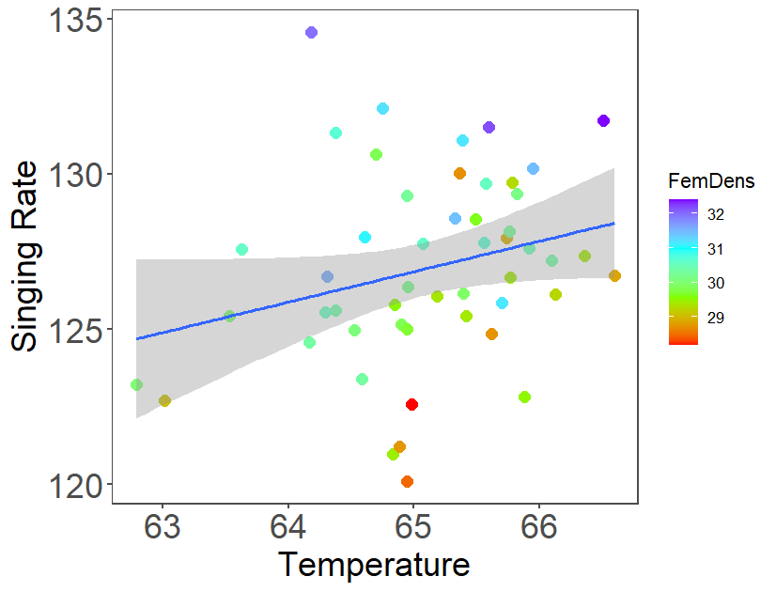
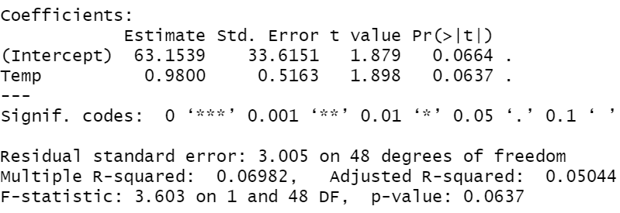
Univariate and multiple regression
Let’s look at the individual relationships between Singing Rate and Temp and between Singing Rate and Female density with plots and models:
First Singing Rate and Temperature
M_Temp=lm(SingRate~Temp,data=m)
summary(M_Temp) #Model with just Temp
Q1: What is the estimate of the slope? Is it close to the real value we used to create the data (1.0)? How precise is our estimate? Can we exclude 0 as a possibility?
0.98. Yes! 95% CI: 0.98 ± 2SE (0.5163) = (-0.05,2.01). No, we can’t exclude 0.
ggplot(m,aes(y=SingRate,x=Temp))+theme_few()+
geom_point(aes(col=FemDens),size=3)+
theme(text=element_text(size=20))+
stat_smooth(method="lm")+labs(x="Temperature",y="Singing Rate")+
scale_color_gradientn(colors = rainbow(4))

Slide 5
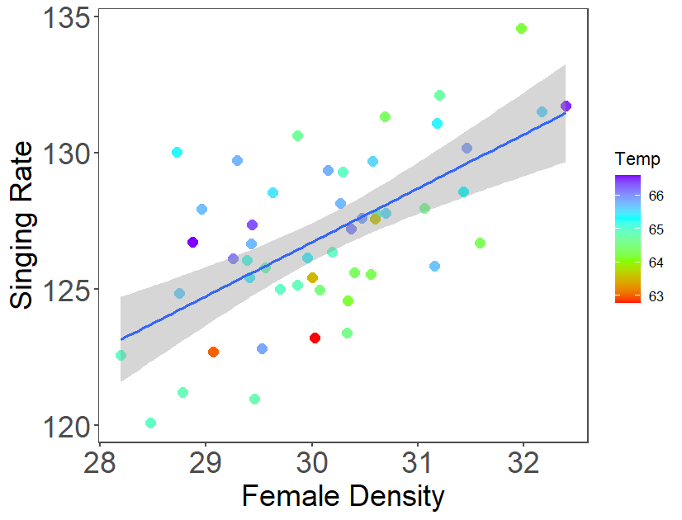
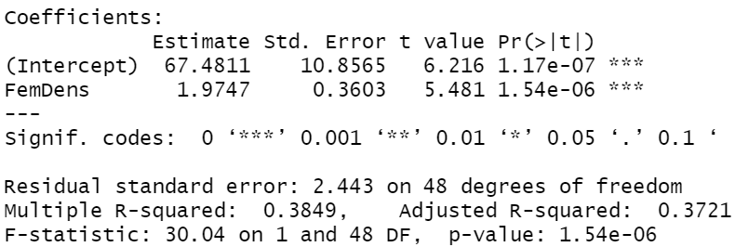
Univariate and multiple regression
Let’s look at the individual relationships between Singing Rate and Temp and between Singing Rate and Female density with plots and models:
Second Singing Rate and Female Density
m_FemDens=lm(SingRate~FemDens,data=m);summary(m_FemDens) #model w/ just female density
Q2: What is the estimate of the slope? Is it close to the real value we used to create the data (2.0)? How precise is our estimate? Can we exclude 0 as a possibility?
1.97. Yes! 95% CI: 1.97 ± 2*0.36 = (1.25,2.69). Yes, we can exclude 0!
Note from Roxanne: We call this a sensibility check. You should do it, early and often! You’ll catch a surprising number of your own mistakes!
ggplot(m,aes(y=SingRate,x=FemDens))+theme_few()+
geom_point(aes(col=Temp),size=3)+
theme(text=element_text(size=20))+
stat_smooth(method="lm")+labs(x="Female Density",y="Singing Rate")+
scale_color_gradientn(colors = rainbow(4))

Slide 6
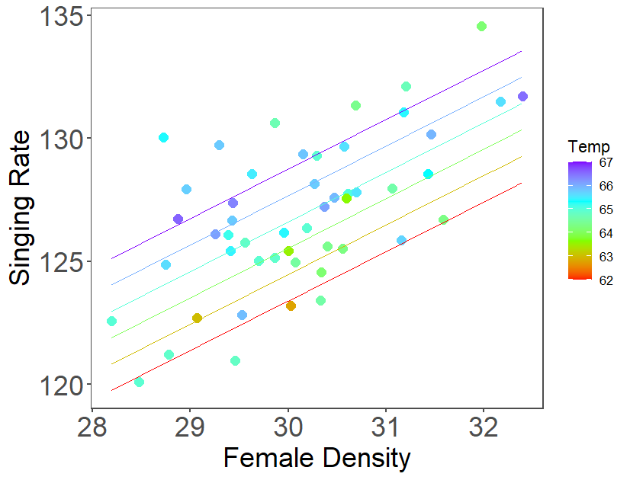
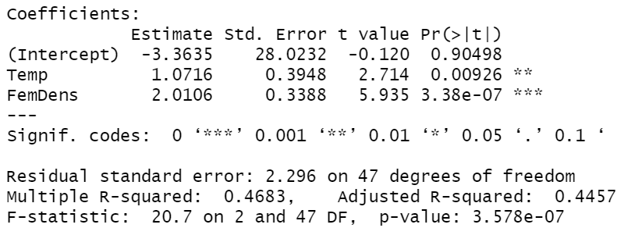
Univariate and multiple regression
Now let’s fit both predictors at the same time
m_Temp_FemDens=lm(SingRate~Temp+FemDens,data=m)
summary(m_Temp_FemDens)
Q3: What are the estimates of the slopes? Are they close to the real values we used to create the data (1.0, 2.0)? Are they much different from the estimates in the univariate regressions with just one predictor?
1.07, 2.01. Yes! Not much different but SEs are a little smaller!
Q4: What is the relative effect of each predictor based on the slopes, and the plot with the fitted model (note the range of the two predictors)?
FemDens is 2x stronger than Temp based on slopes. Singing rate increases ~5 across range of Temp (5F), and ~8 across range of FemDens (4 units).
FemDensv=seq(min(m$FemDens),max(m$FemDens),by=0.1);Temps=62:67 nd1=data.frame(Temp=rep(Temps,length(FemDensv)),FemDens=rep(FemDensv,length(Temps)))
nd1$SingRate=predict(m_Temp_FemDens,newdata=nd1)
ggplot(m,aes(y=SingRate,x=FemDens))+theme_few()+
geom_point(aes(col=Temp),size=3)+
theme(text=element_text(size=20))+
labs(x="Female Density",y="Singing Rate")+
geom_line(data=nd1,mapping=aes(x=FemDens,y=SingRate,col=Temp,group=Temp))+
scale_color_gradientn(colors = rainbow(4))

Slide 7
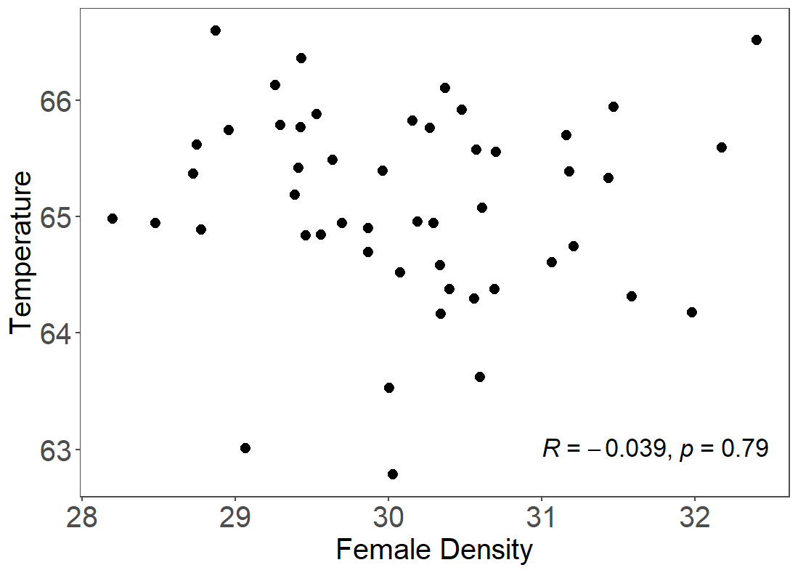
Multiple regression is easy?
I thought you said it was going to be difficult. Why was it so easy?
#1 Reason: the two predictors were almost completely uncorrelated (see figure)
When predictors are uncorrelated, slopes are unaffected by the presence of other variables
The main effect of adding variables is to shrink RSE (and SEs of slopes) if added variables explain more variation than we’d expect by chance
ggplot(m,aes(y=Temp,x=FemDens))+geom_point(size=3)+theme_few()+
theme(axis.title=element_text(size=20),axis.text=element_text(size=20))+
labs(x="Female Density",y="Temperature")+
ggpubr::stat_cor(label.x = 31, label.y = 63,size=6)
I’ve done something new here: I’ve used a function inside a package I haven’t loaded (stat_cor inside the ggpubr package)

Slide 8
Next: Multiple regression with groups and continuous predictors (and interactions)
Interpreting R’s output when you have both groups and continuous predictors is a little tricky, especially when you are modeling an interaction
What is an interaction?

Slide 9
Interactions
Any time you have a model with 2 or more predictors, it’s possible that there might be an “interaction” among the variables in their influence on the response
Biologically, this means that the influence of one predictor on the response depends on the level of the other response. This is quite common in nature:
The growth of a plant may depend on both water and soil nitrogen.
However, the effect of water on plant growth may itself depend on how much nitrogen is present.
Interactions can be “synergistic” (the effect is larger than additive) or “antagonistic” (the effect less than additive)
Interactions make analyses more difficult to interpret.
Let’s do a (simple) example!

Slide 10

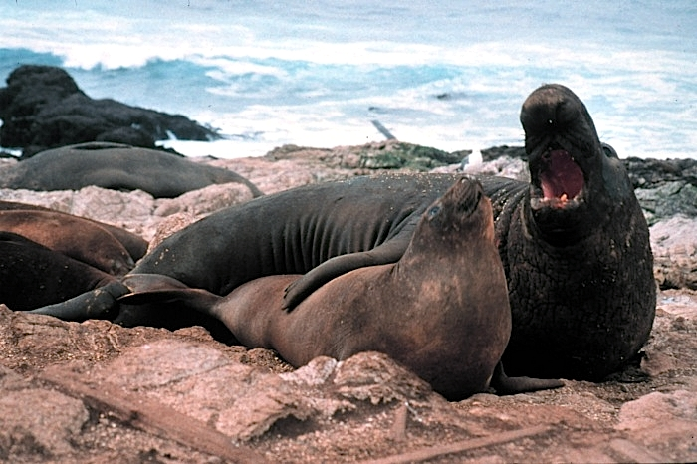
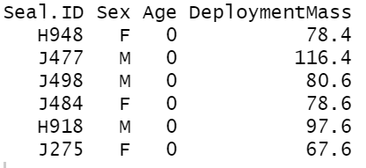
Sex differential growth? Elephant seals at Año Nuevo
Dr. Roxanne Beltran and her team are investigating sex-specific differences in the development of several traits in elephant seals.
Adult males are ~2000kg whereas adult females are ~400kg.
We would like to describe the size-age trajectories for males and females
In the 1st part of the study Dr. Beltran’s team measured the mass of 32 elephant seals, age 0-3 years, with 16 males and 16 females
m=read.csv("NSFRoD2022_Deployment_Summary_RSB.csv")
head(m[,c("Seal.ID","Sex","Age","DeploymentMass")])

Slide 11
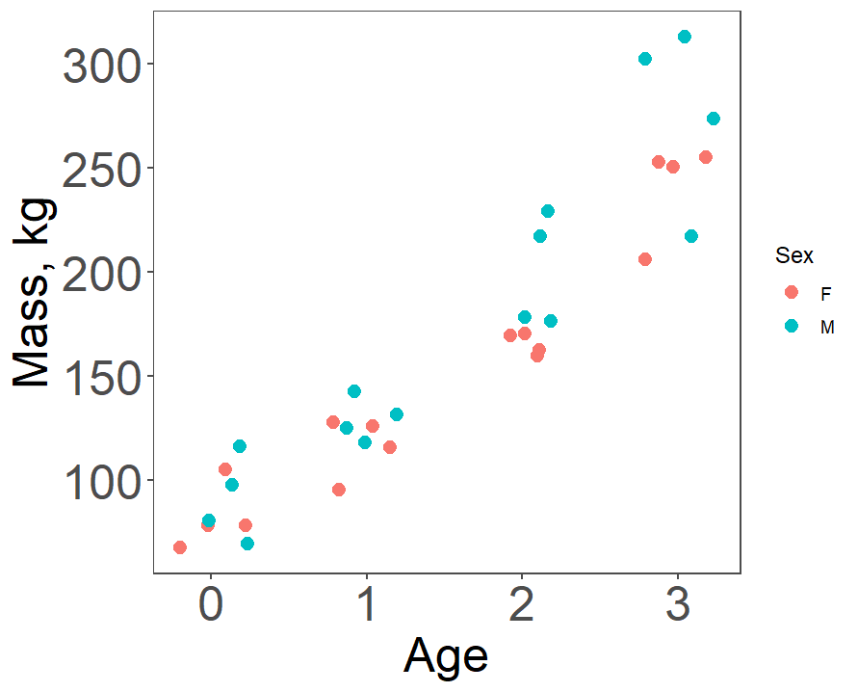
First, plot the data!
Eyeball analysis:
Data look roughly linear within each group, and variation around line(s) looks approximately normal (yay!)
Mass at age 0 appears to be similar, but by age 2 or 3 males appear to be larger (although sample sizes are small and the data are variable)
Let’s analyze the data rigorously!
ggplot(m, aes(y=DeploymentMass, x=Age, color=Sex))+ theme_few()+ ylab("Mass, kg")+ geom_jitter(height=0, width=0.25,size=3)+ theme(text=element_text(size=25))

Slide 12
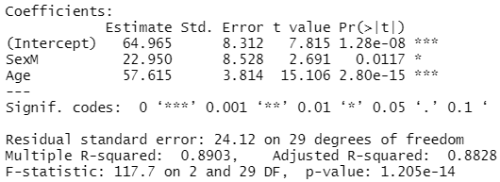
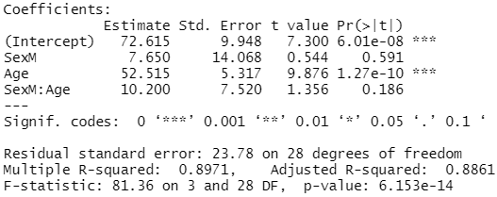
Sex-specific growth?
We’ll fit a model where mass is the response and both Sex and Age are predictors. First an “additive model”:
f1=lm(DeploymentMass~Sex+Age,data=m); summary(f1)
Then we’ll allow for the effect of age to differ between sexes (sex-specific growth rates), by including an interaction (*)
f2=lm(DeploymentMass~Sex*Age, data=m); summary(f2)
These models are both fitting two lines to the data
Q5: How do the lines differ in the additive model? How do they differ in the interactive model? What do these two models suggest about the increase in mass with age and sex? Are males heavier than females? Do males grow faster than females?

Slide 13
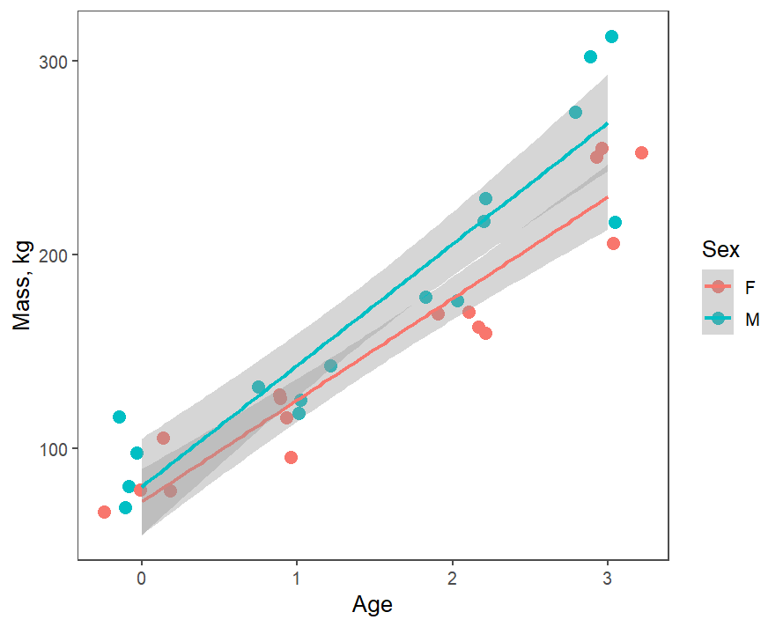
Sex-specific growth?
Additive model (2 parallel lines):
f1=lm(DeploymentMass~Sex+Age,data=m); summary(f1)
Suggests males are 23kg (95% CI: 6-40kg) bigger (higher intercept) across all ages; model gives a single estimate for growth=57.6 (50.2-65.2) kg/yr
Interaction model (2 lines w/ different intercepts & slopes; see figure*)
f2=lm(DeploymentMass~Sex*Age, data=m); summary(f2)
Model suggests difference in intercept (at age 0) is likely due to chance (P = 0.59); possible difference in slopes (growth rates) but difference may be due to chance (P = 0.186); can’t exclude no difference
Q6: What are estimated slope & intercepts of males & females in interaction model?
*ggplot(m, aes(y=DeploymentMass,x=Age,color=Sex))+ geom_jitter(height=0,width=0.25,size=3) + theme_few()+
ylab("Mass, kg")+stat_smooth(method="lm")

Slide 14
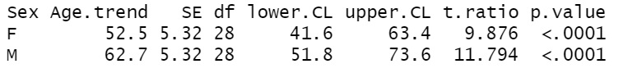
Interpreting Interactions
Q6: What are estimated slope & intercepts of males & females in interaction model?
R picks “reference” group alphabetically (F before M)
Intercept & slope of continuous predictor are for reference group
Intercept and slopes for other group(s) are differences b/w that group and reference group, reported as PredictorGroup for intercept and PredictorGroup:Continuous predictor
Female intercept&slope: 72.615 & 52.515*Age
Male intercept&slope: 72.615+7.650 & 52.515+10.2 = 62.7*Age
Easier ways (but lose comparison):
emmeans::lstrends(f2,"Sex",var="Age",infer=T)
Or: f2b=lm(DeploymentMass~Sex+Sex:Age, data=m); summary(f2b)

Slide 15
Interpreting interactions
When data support an interaction (not clear in sex-specific growth rates for e-seals with initial data) interpretation requires care
Interpreting significance of “main effects” (in our case, age, sex) can be tricky.
We can compare differences in intercepts and slopes between categorical variable (i.e. sex), but we often can’t make simple statements (e.g. males are bigger) because interaction effect means that the difference between sexes in size varies age!
It’s especially challenging to interpret main effects if interaction effect creates a crossing pattern
e.g. if males had started smaller but grew faster – we wouldn’t want to say males are bigger or smaller! We’d want to describe full pattern.

Slide 16
Hopefully, we now understand multiple regression when things are relatively easy
What about when predictors are correlated?

Slide 17
Multiple regression with slightly correlated predictors
Make some cricket-temperature-humidity data where you know the relationships!
lapply(c("tidyverse", "ggthemes","car"), require, character.only=T)#packages
set.seed(2) #make example repeatable
m2=mvtnorm::rmvnorm(n=50, mean=c(65,65), sigma=matrix(c(5,-2,-2,5), ncol=2))
colnames(m2)=c("Temp","Humid")
m2=as.data.frame(m2)
m2=m2 %>% mutate(SingRate=.25*Temp+.25*Humid+rnorm(50,2,1.5))
First, plot the data!

Slide 18
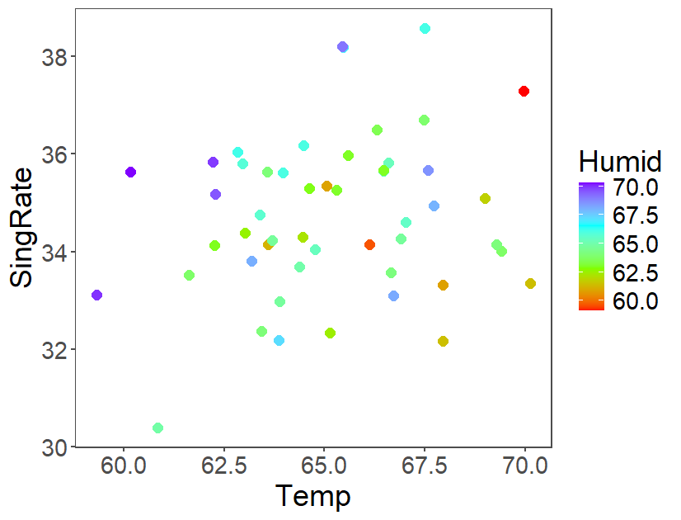
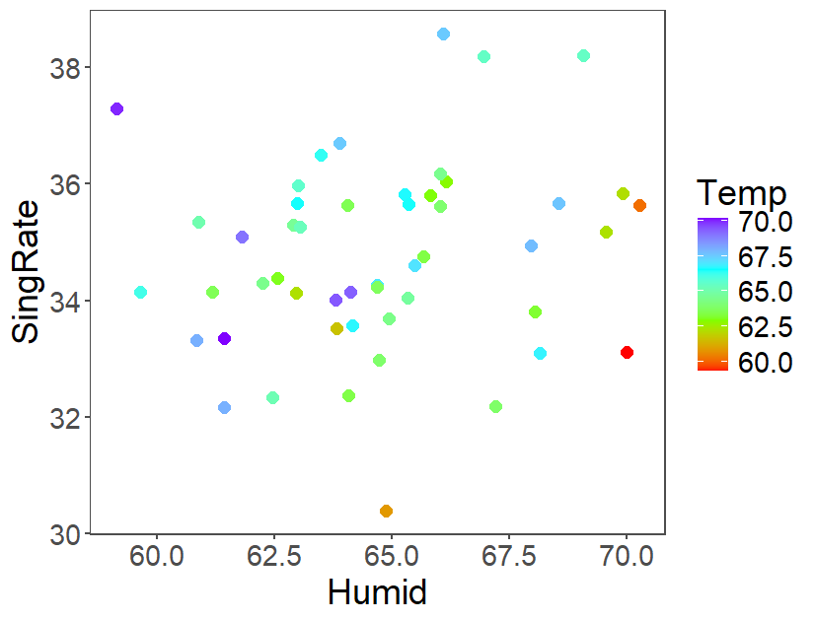
Plot the data
Q7: What do the plots suggest about the relationships between Singing Rate and Temperature and Singing Rate and Humidity?
No pattern at all! Eek!
Is that weird since we created the data and we know Singing Rate should increase with both humidity and temperature?
What do simple models suggest?
ggplot(m2,aes(y=SingRate,x=Temp,col=Humid))+geom_point(size=3)+theme_few()+
theme(text=element_text(size=20))+
scale_color_gradientn(colors = rainbow(4))
ggplot(m2,aes(y=SingRate,x=Humid,col=Temp))+geom_point(size=3)+theme_few()+
theme(text=element_text(size=20))+
scale_color_gradientn(colors = rainbow(4))

Slide 19
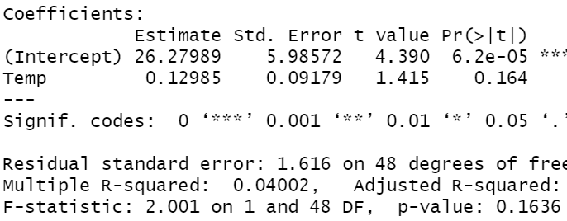
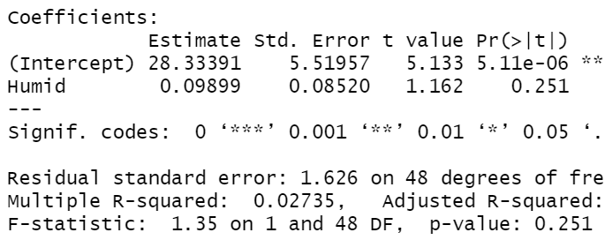
2 simple univariate models
Singing rate vs Temperature & humidity:
f1=lm(SingRate~Temp,data=m2);summary(f1)
f2=lm(SingRate~Humid,data=m2);summary(f2)
Q8: What are the slopes? Do they match the values we used to make the data (0.25)? What should we try next?
Temp: 0.13 (95% CI: -0.05,0.31)
Humid: 0.099 (95% CI: -0.07,0.27)
Sort of (CIs include real values but barely)
Fit a model with both!

Slide 20
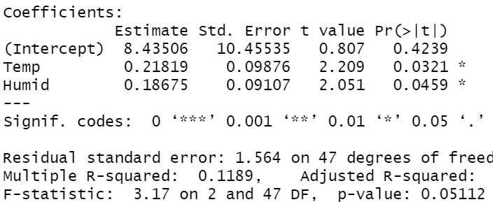
Multiple regression model
Let’s put both predictors in at the same time:
f3=lm(SingRate~Temp+Humid,data=m2); summary(f3)
Q9: What does this model suggest? What are the slopes & P-values? Do they match the values we used to make the data (0.25)? Why did we get these results and why are they different from the univariate relationships?
Temp: 0.22 (95% CI: 0.02,0.42)
Humid: 0.19 (95% CI: 0.01,0.37)
Much better (estimates much closer to true values)
Because the two predictors are negatively correlated! (see next slide)

Slide 21
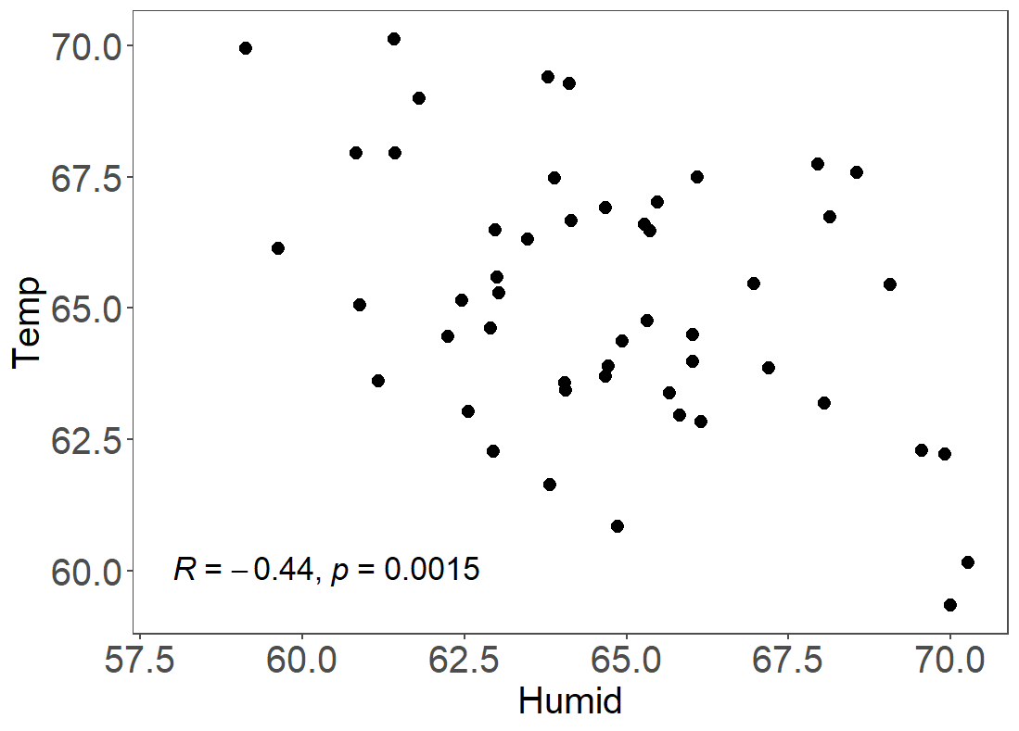
Multiple regression with correlations among predictors
If predictors are correlated (see figure!), multiple regression slopes are often very different than in univariate analyses (plots can look weird!)
If predictors are negatively correlated and both are positively related to response (as we had here), then the 2 predictors mask each others’ effects & they are less detectable in univariate regressions (and x-y plots!!!)
If predictors are positively correlated and both are positively related to response, then the two predictors are partially redundant and their significance in multiple regression will be lower than in univariate regression
I’ll show extreme examples of both later
First, let’s understand how we get slopes in multiple regression
ggplot(m2,aes(y=Temp,x=Humid))+geom_point(size=3)+theme_few()+
theme(axis.title=element_text(size=20),axis.text=element_text(size=20))+
ggpubr::stat_cor(label.x=58,label.y=60,size=6)

Slide 22
How are slopes calculated in multiple regression?
When you fit multiple predictors, Y = c₀+c₁x₁+c₂x₂, lm() reports what are called Type III sum of squares. In essence, the results indicate the additional “unique” impact of a given variable after the others have been taken into account.
Specifically, the slope of a given predictor (e.g. x₁) in a multiple regression is the same as:
lm(resid(lm(Y~x₂))~resid(x₁~x₂))
I showed you this once before (cricket chirping rate, temperature, and female density!)
Including more variables can change the slope and make a given variable increase or decrease in significance depending on whether the new variables are correlated with a given variable and explain some of the same variation in Y. Let’s say that another way…

Slide 23
Slopes in multiple regression, partial correlations
In multiple regression, the slopes for each predictor are the “unique” contribution of that predictor on the response, when other predictors are accounted for in both the response and the predictor! That’s complicated.
In a regression of Y ~x₁+x₂, the slope of x₁ is obtained by regressing Y on x₂ and taking the residuals (to account for the effects of x₂ on Y); the residuals of this become the response variable. But to get the “unique” contribution of x1, we have to get the residuals of the regression of x₁ on the other predictor x₂ (to remove any correlation b/w x₁ and x₂):
Slope of x₁: (Residuals of Y vs x₂) ~ (residuals of x₁ vs x₂)
We can also calculate the correlation of the same residual variables; this is called the “partial correlation coefficient” and measures the strength of the unique contribution of x₁; it varies from -1 to 1 just like normal correlation coefficient w/0 indicating no correlation
The same is true for x₂. It’s the unique contribution of x₂ after accounting for x₁.
Let’s see an example!

Slide 24
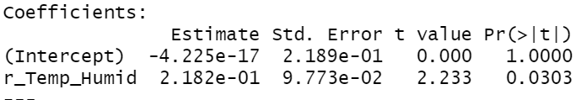
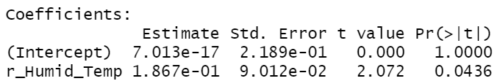
Multiple regression model
In our multiple regression:
f3=lm(SingRate~Temp+Humid,data=m2); summary(f3)
Slope for Temp is:
r_SR_Humid=resid(lm(SingRate~Humid,data=m2))
r_Temp_Humid=resid(lm(Temp~Humid,data=m2))
summary(lm(r_SR_Humid~r_Temp_Humid))
Slope for Humidity is:
r_SR_Temp=resid(lm(SingRate~Temp,data=m2))
r_Humid_Temp=resid(lm(Humid~Temp,data=m2))
summary(lm(r_SR_Temp~r_Humid_Temp))
The SEs of these slopes and their P-values depend on how much variation the other variable explained in Y and them (here not much).

Slide 25
Now we understand the basics and complications of multiple regression
Let’s see how we should, and shouldn’t, build multiple regression models

Slide 26
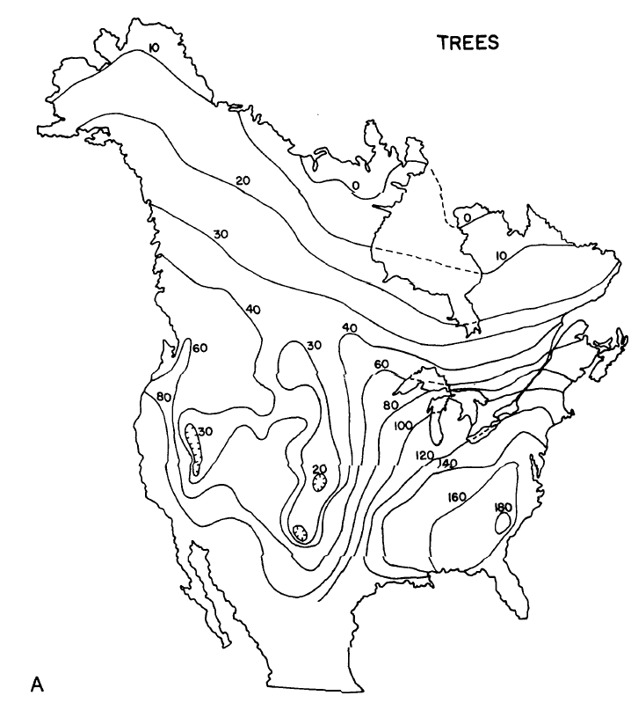
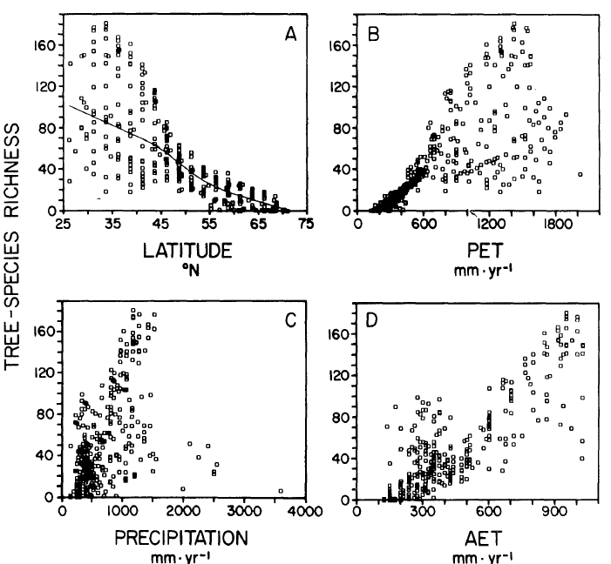
Multiple regression
Currie 1991 Am Nat
Imagine we have multiple predictor variables and we want to know which ones influence a response variable Y, and quantify their influence
E.g., We want to understand spatial/latitudinal patterns of species diversity and our predictors are precipitation, potential evapotranspiration (PET) (?!), actual evapotranspiration (AET), temperature, elevation, range of elevation , etc. (see Figs)
This is a super common, but super challenging problem because, if any variables are correlated (and many of them are highly correlated), then
Inclusion of one variable will change both slope/coef and P-value of other variables; size of effect depends on correlation b/w predictors and b/w predictors and response
What should we do?

Slide 27
What we used to do but should not have done, round 1…
Build a “full” model (i.e. put all predictors in 1 model) and then sequentially drop/remove non-significant variables.
If multiple variables are non-significant, drop the one with the highest p-value first.
This is called “backwards step-wise regression”.
Unfortunately, it produces biased slopes, incorrect p-values, and can generate serious misunderstandings!
Let’s do an example

Slide 28
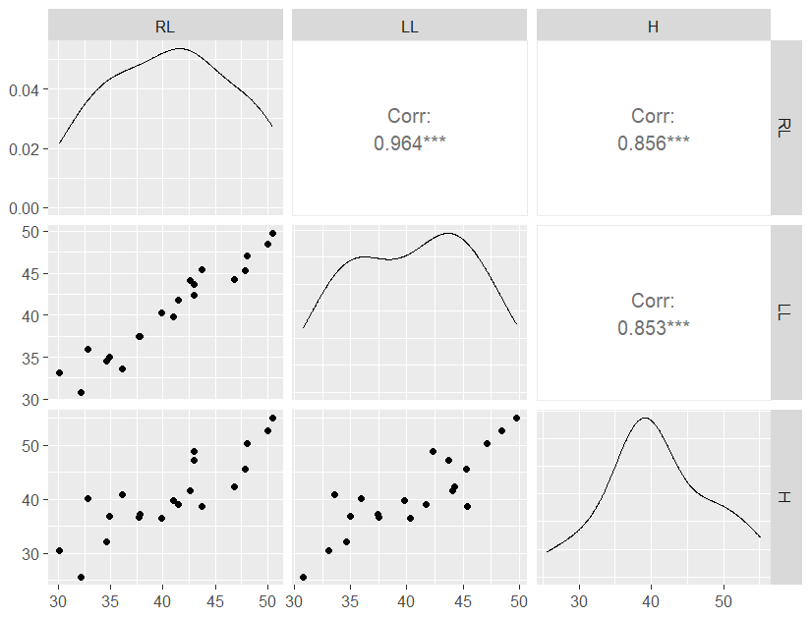
Challenges of variable selection: positively correlated predictors
Imagine you measure the length of many people’s right and left legs (RL and LL) and their height (H); their height is the average of their leg lengths plus their torso length (which is variable)
Create some data with known relationships/slopes:
set.seed(2);RL=rnorm(20,mean=31:50,sd=1)
LL=rnorm(20,mean=31:50,sd=1)
H=0.5*RL+0.5*LL+rnorm(20,sd=3)
df=data.frame(RL=RL,LL=LL,H=H)
First, plot the data:
GGally::ggpairs(df,columns=c("RL","LL","H"))
Q10: What do the plots suggest about the relationships between Height (H) and either the right leg (RL) or left leg (LL) (see bottom row)
Very strong relationships for both legs!

Slide 29
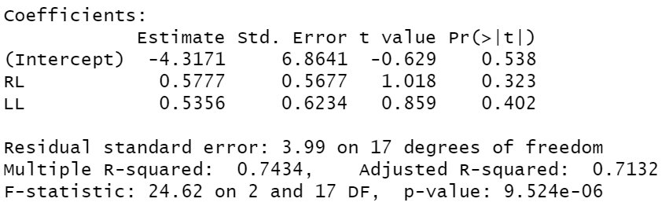
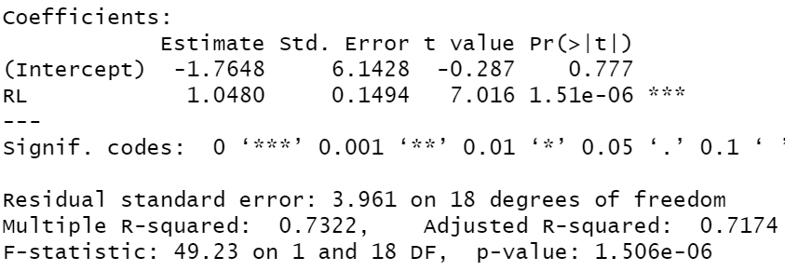
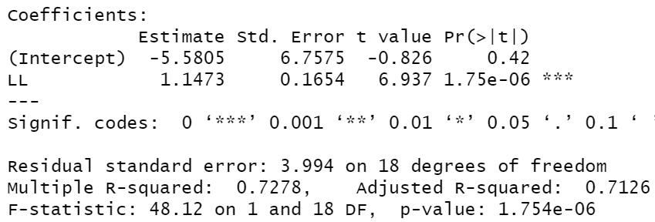
Challenges of of variable selection: Leg length & height
Let’s fit models with both legs and models with either leg :
summary(lm(H~RL+LL,data=df))
summary(lm(H~RL,data=df))
summary(lm(H~LL,data=df))
Remember, the true slopes of RL and LL are 0.5
Q11a: What the hell is going on with the P-values (& slope SEs) in the model with both legs???
Q11b: Why are the slopes in the models with just RL or LL so far off? What are the 95% CI for the slopes from the fitted models?
Q11c: What are the slopes and 95% CI in the model with both RL and LL?

Slide 30
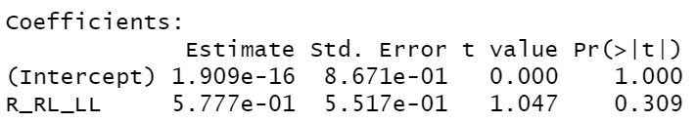
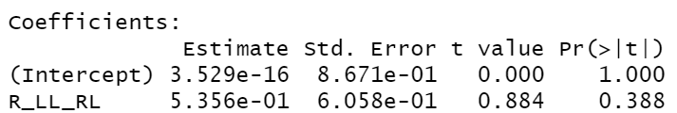
Reminder: how are slopes calculated in multiple regression?
Slopes are unique contribution of predictor when other predictor(s) are already accounted for & after removing correlation with other predictor(s)
Specifically, the slope for RL is:
R_RL_LL=resid(lm(RL~LL)) #resids of RL on LL
R_H_LL = resid(lm(H~LL)) #resids of H on LL
summary(lm(R_H_LL~R_LL)
And the slope for LL is similar:
R_LL_RL=resid(lm(LL~RL))
R_H_RL = resid(lm(H~RL))
summary(lm(R_H_RL~R_LL_RL))
Why are the SEs so high in the multiple regression model?

Slide 31
Variance inflation due to collinearity
SEs of the slope (sqrt(diag(X’X)⁻¹)*s²)) for predictors in multiple regression are “inflated” by a factor sqrt(1/(1-R²)) where R² is the variance in that predictor explained by the other predictors. Inflation is due to lower (X’X), not higher s² (RSE).
Since RL is highly correlated with LL, R² for LL vs RL (or vice versa – it’s the same!) is very large (R² = 0.93)
SEs are inflated by sqrt(1/(1-0.93))= sqrt(14.24)=3.77! (0.56=~0.1494*3.77)
Neither RL or LL are significant in the model with both RL and LL, despite both being highly correlated with H because they are redundant. Neither makes a unique contribution if the other is already in the model, but model with both or either one are very good (R²>73%; P = ~10^{-5 or} 10⁻⁶)!

Slide 32
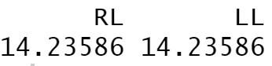
Variance inflation due to collinearity has a name
There is a measure of the inflation of each SE:
The variance (SE²) inflation factor: VIF = 1/(1-R²).
There are back of the envelope rules for what is ok (<10, 5, 4, 2.5) but they are all BS, as we’ll see.
You can obtain vif values with vif(model) in the car package
car::vif(lm(H~RL+LL))
The same as we got on last slide: 1/(1-0.93) = 14.24
They are the same b/c there is only 2 predictors in the model & r_{x1x2}=r_{x2x1} so 1-R² is the same for both.

Slide 33
What we used to do but should not have done round 1: backwards step-wise regression
Let’s see what happens with backwards stepwise regression (BSWR)
Start with a “full” model (i.e. put both RL and LL in 1 model) and then sequentially drop non-significant variables until all remaining variables are significant. If multiple variables are non-significant, drop the one with the highest p-value first.
summary(lm(H~RL+LL))
Q12: What would we do with these results using the procedure above for BSWR?

Slide 34
What we used to do but should not have done round 1: backwards step-wise regression
Start with a “full” model (i.e. put both RL and LL in 1 model) and then sequentially drop non-significant variables until all remaining variables are significant. If multiple variables are non-significant, drop the one with the highest p-value first.
LL has highest P-value so remove it from model and refit with just RL:
summary(lm(H~RL))
RL is significant so we are done!
Q13: What is the problem with reporting this as our best model for understanding which predictors influence height?

Slide 35
What we used to do but should not have done round 1: backwards step-wise regression
We would have dropped LL and attributed all variation in H to RL! But we know both legs contribute to height!
We’d get the biology wrong!
Also, the true slope of RL was 0.5, and the true slope is not contained in the 95% CI (0.75-1.35)!

Slide 36
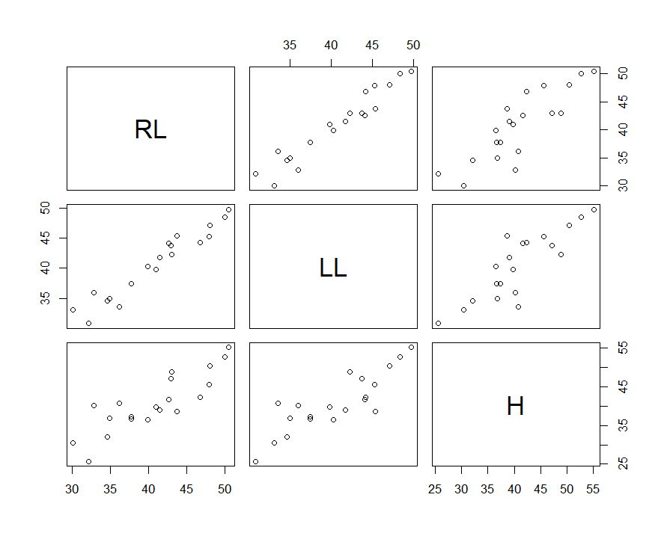
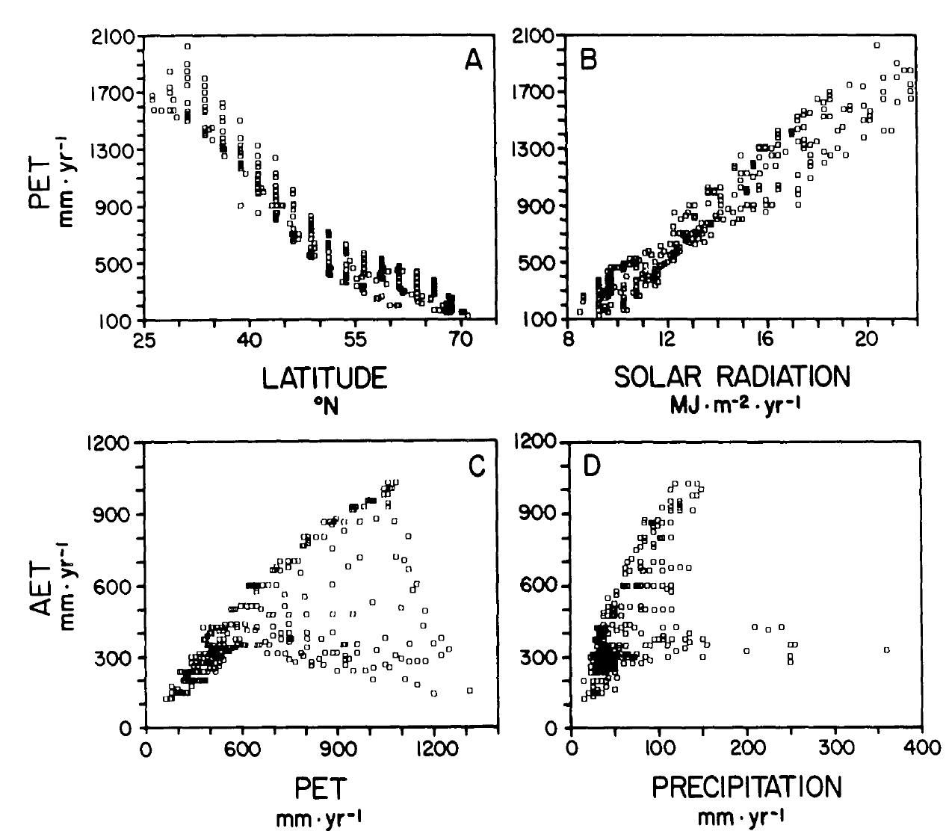
How common is this problem?
Did I give you a dumb example? Are real predictors ridiculously correlated like that?
Oh yes! Remember the species diversity example I gave you? Look at the correlations between Latitude, Temperature, PET, & solar radiation? What about PET and AET?
What if we wanted to know what is more important for mosquito borne disease: drought or temperature (Paull et al 2017 PRS B)? What do you think is the correlation between drought and temperature?
High correlations among predictors is VERY common!
Currie 1991 Am Nat

Slide 37
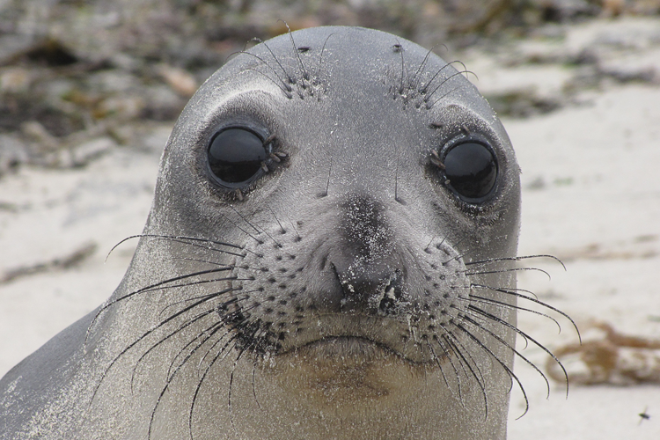
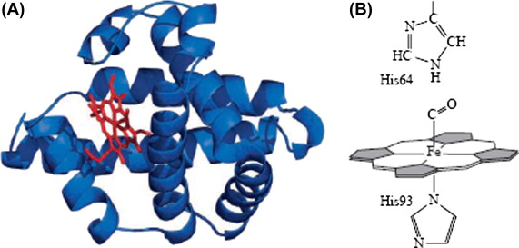
How about a real world example where predictor correlations totally change our interpretation?
The data? Elephant seals! #sorrynotsorry
Myoglobin in juvenile elephant seals. Myoglobin plays key role in muscle O2 storage (and thus diving ability in eseals!). We know bigger seals can dive for longer.
Question: how does muscle myoglobin vary with mass? Do heavier seals have more myoglobin and this helps them dive longer?
Note from Roxanne: Thanks to Zabe and Salma, PhD students on this project, and our collaborator Nicole Thometz who ran the samples!

Slide 38
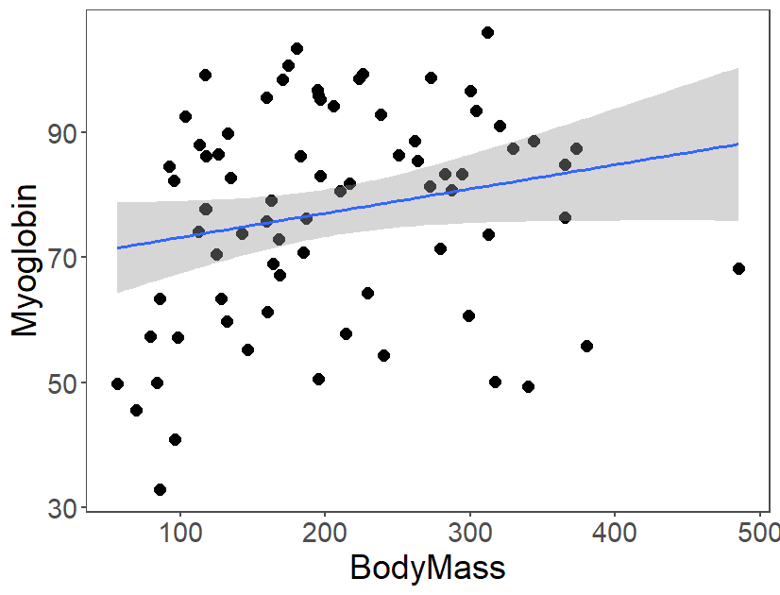
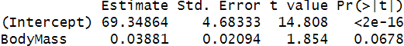
Myoglobin & Mass
Myoglobin does increase (marginally) with mass (P=0.067)!
But is this relationship causal?
What else might be influencing Myoglobin and does it also vary with mass?
Age and Sex!
Let’s see how including these variables affects our interpretation!
m=read.csv("RoD 2022-2024 Juvenile NES Mb Values.csv")
m=m[complete.cases(m),]
ggplot(m,aes(x=BodyMass,y=MeanMb))+theme_few()+ geom_point(size=3)+stat_smooth(method="lm")+ theme(text=element_text(size=20))+
labs(y="Myoglobin")
summary(lm(MeanMb~BodyMass,data=m))

Slide 39
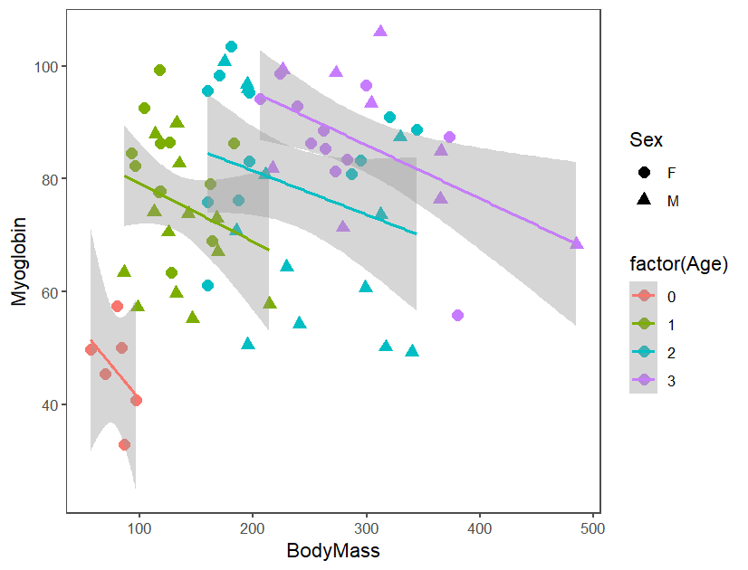
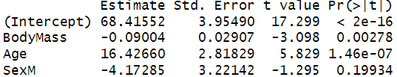
Myoglobin, Mass,
Age, Sex
When accounting for Age, myoglobin decreases with Mass!
Increase w/ Mass was spurious and due to the strong correlation b/w Age and Mass (r = 0.8!)
Sex effect isn’t strong but shouldn’t be removed (more on this later!)
Correlation among variables changed the biology completely!
ggplot(m,aes(x=BodyMass,y=MeanMb,color=factor(Age) ))+theme_few()+
geom_point(aes(shape=Sex),size=3)+stat_smooth(method="lm")+
labs(y="Myoglobin")
summary(lm(MeanMb~BodyMass+Age+Sex,data=m))

Slide 40
Correlations among variables can complicate/reverse interpretation of regression analyses!
We just covered why backwards stepwise regression with correlated predictors produces biased statistics and incorrect biological conclusions.
What other options exist?

Slide 41
What we used to do but should not have done, round 2: forwards step-wise regression
Since backwards stepwise regression didn’t work so well, you might think that maybe another approach could work.
There’s another one called “Forwards stepwise regression”
Forwards stepwise regression: First do univariate correlations (Y and each predictor, x1, x2, etc.) and then add most significant predictor. Then try adding remaining predictors, one at a time, and only keep them if they are significant.
Does this work better? (I bet you can guess the answer).
For our leg length example, it would result in the same final model (only RL)
But it can be even worse than that! Let’s see how!

Slide 42
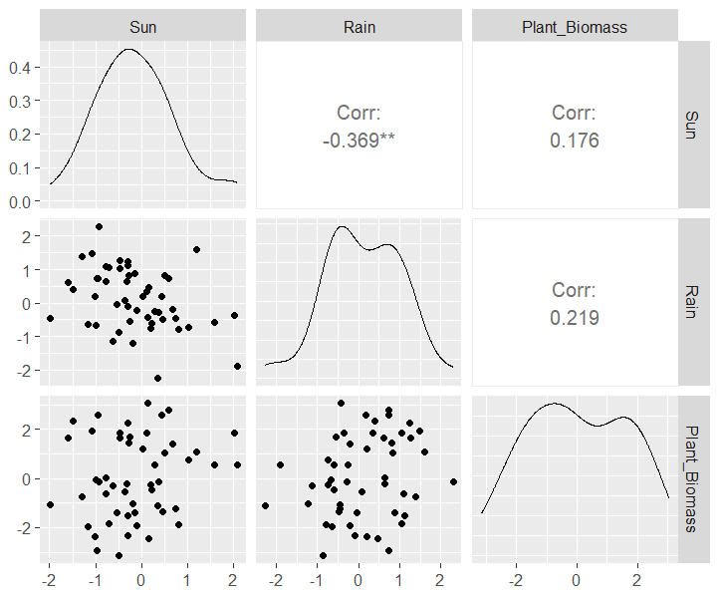
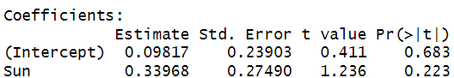
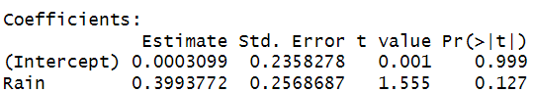
Forwards step-wise regression with negatively correlated predictors
set.seed(12) #Make repeatable data
Sun=rnorm(50);Rain=-0.3*Sun+rnorm(50) #Neg correlation
Plant_Biomass=.5*Sun+.5*Rain+rnorm(50,0,1.5)
df=data.frame(Sun=Sun,Rain=Rain,Plant_Biomass=Plant_Biomass)
GGally::ggpairs(data=df,columns=c("Sun","Rain","Plant_Biomass"))
summary(lm(Plant_Biomass~Rain));summary(lm(Plant_Biomass~Sun))
Q14: Is either predictor is significant? If neither is, we’ll have to conclude the null model (y~1; the grand mean with no predictors!) is best.
Neither are significant. Sad…
Q15: Since you know how the response variable was created (Plant_biomass is causally related to both Sun and Rain), why are we getting the results we did?
Because predictors are negatively correlated! cor.test(Sun,Rain); r_{x1,x2} = -0.368
Q16: What if we try a full model with Sun & Rain? (this isn’t allowed in Forward stepwise regression).

Slide 43
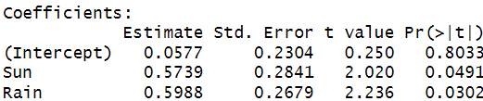
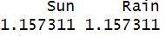
Forwards step-wise regression fails
summary(lm(Plant_Biomass~Rain))
summary(lm(Plant_Biomass~Sun))
summary(lm(Plant_Biomass~Sun+Rain))
Q17: How much is the variance (SE²) of the slopes inflated?
car::vif(lm(Plant_Biomass~Sun+Rain))
Not much! No vif rule (vif>2,5,10) would have stopped us!
Q18: What happened? Why are results from multiple regression so different from univariate results?

Slide 44
Forwards step-wise regression fails
Forwards stepwise regression fails here because:
If two causally influential predictors are negatively correlated, then their univariate relationships with response will be masked and be (much) weaker than their real relationships (slopes are biased low)
Both variables can be non-significant in univariate analyses (as they were here!), even if both are causally related to Y and significant in a multiple regression!

Slide 45

So stepwise regression (backwards or forwards) doesn’t work…
Wait!
I heard AIC was cool. Doesn’t AIC solve everything?
Can’t we just compare models with subsets of predictors by AIC and pick the model with the lowest AIC?
Further Reading: https://dynamicecology.wordpress.com/2015/05/21/why-aic-appeals-to-ecologists-lowest-instincts/

Slide 46
What is AIC?
AIC stands for Akaike’s Information Criterion, and is a way to measure the prediction error of a model M (specifically the loss of information due to fitting a simplified model to the data)
AIC is a very simple calculation:
AIC = 2k-2*ln[likelihood(M)], where
k is the # of parameters in the model (including the residual standard error, so a single predictor regression has k=3), and
ln[likelihood(M)] is log_{e}(likelihood) of the data given the model and parameter estimates
What is the “likelihood” of the data?

Slide 47
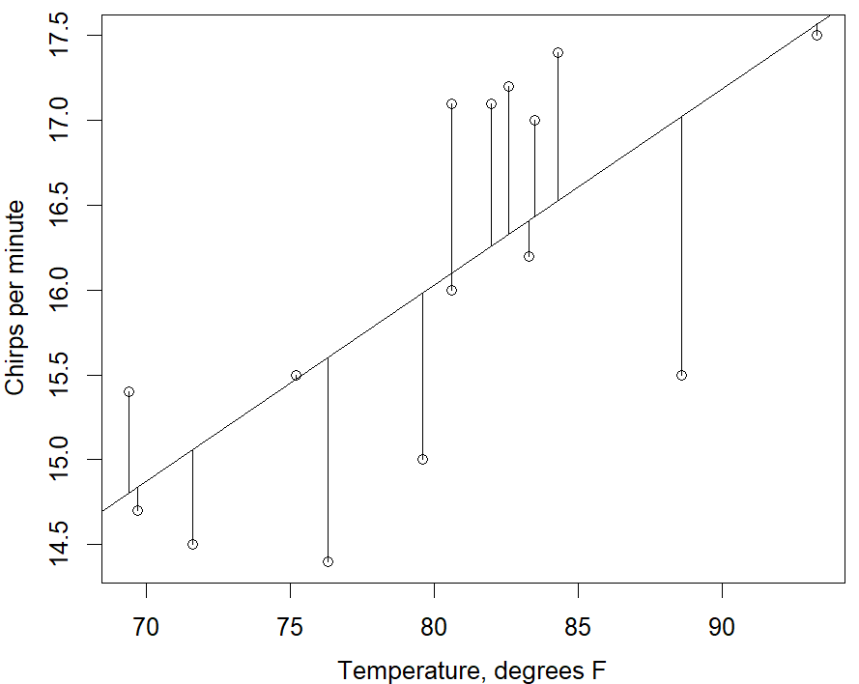
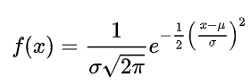
Likelihood
All combinations of models and data have likelihoods; the likelihood function depends on the distribution of the response variable
The “likelihood” of a single data point x, given a normal distribution with mean μ and sd sigma, is:
For a linear model, the fitted line gives the value of μ (Y_{pred}) and σ is the RSE
We can get the likelihood of a point in R with dnorm(x,mu,sigma)
The log-likelihood of “the data” is the sum of the log of the individual likelihood values given the fitted model (e.g. a line)
Y_{i}-Y_{pred}

Slide 48
Maximum likelihood estimates
When we get the “best fitting parameters” for a model, we are usually finding the “maximum likelihood estimates”*
For a Gaussian/normal distribution, maximizing the likelihood is the same as minimizing the sum of squared errors because the likelihood is proportional to the squared errors:
Later we’ll use other distributions for the response variable that have different likelihood expressions
*We actually find the MLEs by minimizing the negative log-likelihood but that’s an optimization issue you don’t have to worry about!

Slide 49
Back to AIC
AIC* = 2k-2*ln[likelihood(M)], where k is the # of parameters in the model
AIC has been used to compare how good/bad different models are at fitting the data; lower is better!
The better the fit to the data, the higher the likelihood. AIC = 2k – 2LL so the lower the AIC the better
If two models have the same likelihood (fit to the data) and one has more parameters, k, it is worse by AIC b/c we penalize it for the extra parameters
Specifically, we add 2 to the AIC for each parameter (2k)
The best fitting model is the one that as the lowest AIC (least positive or biggest/most negative)
*When sample sizes are small, relative to model complexity (i.e. n/k<40), AICc is recommended.
AICc = AIC+2k(k+1)/(n-k-1) which favors less complex models. As n gets big AICc converges to AIC.

Slide 50
Why doesn’t AIC solve all our problems?
Why isn’t picking the single best model based on AIC ok?
Because selecting a model that has some predictors removed because it has a lower AIC is the same thing as step-wise regression!
The model with the predictors removed has biased slopes, and inappropriately assigns all variance explained to remaining predictors
Let’s do a quick example to see this!

Slide 51
Selecting a single model using AIC is the same as stepwise regression
Make data where we know the true model & slopes:
set.seed(2);Sun=rnorm(50);Rain=-Sun+rnorm(50);#negatively correlated with Sun
Tree_Biomass=0.5*Sun+0.5*Rain+rnorm(50,0,1.5)
df2=data.frame(Sun=Sun,Rain=Rain,Tree_Biomass=Tree_Biomass)
OR
df2=data.frame(Sun=rnorm(50))
df2=df2 %>% mutate(Rain=-Sun+rnorm(50), Tree_Biomass=.5*Sun+.5*Rain+rnorm(50,0,1.5))
Q19: Plot the three variables w/ GGally::ggpairs(data=df2,columns=c("Sun","Rain","Tree_Biomass")).
Fit 4 lm() models, one (f1) w/ just Sun, one (f2) w/ just Rain, one (f3) with both, and a null model (f0) with neither (lm(Tree_Biomass~1)) & compare by AIC(f0,f1,f2,f3). Which is best? What is vif() for model f3? Use car::vif(f3)

Slide 52
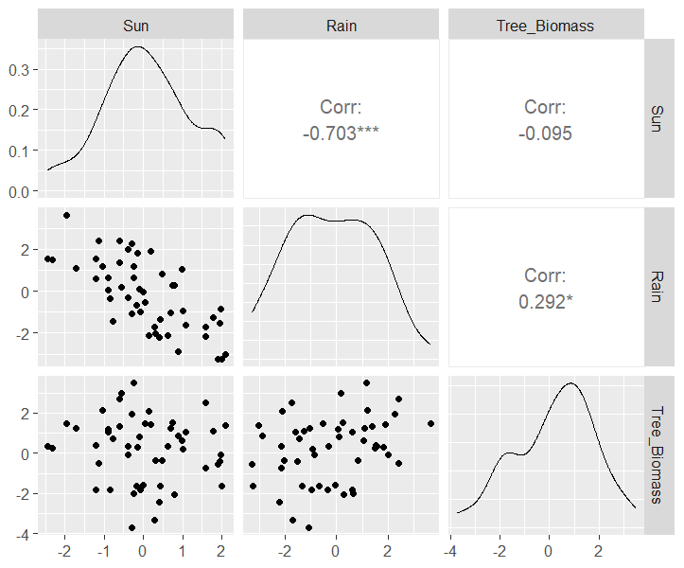
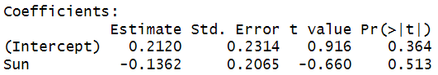
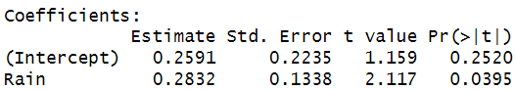
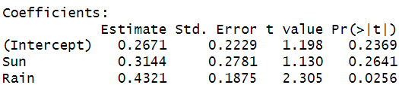


Why doesn’t AIC solve all our problems
f0=lm(Tree_Biomass~1,data=df2);summary(f0); f1=lm(Tree_Biomass~Sun,data=df2);summary(f1); f2=lm(Tree_Biomass~Rain,data=df2);summary(f2); f3=lm(Tree_Biomass~Sun+Rain,data=df2);summary(f3)
AIC(f0,f1,f2,f3); car::vif(f3)
AIC suggests model f2 with just Sun is best even though we know model f3 is the model that we used to create the data!
Also, in model f2, Rain slope is biased low (95% CI, 0.02-0.51 barely includes true value: 0.5)
In multiple regression model f3, slope is close to true value (& 95% CI broadly overlaps 0.5)
VIFs for model f3 are moderately small: 1.977
What happened?
f1
f2
f3
**
**In AIC comparisons or multimodal averaging, it’s standard practice to include a null model, f0=lm(Tree_Biomass~1)

Slide 53
Why doesn’t AIC solve all our problems
Moderately strong correlation among predictors Sun and Rain (see figure) made variables partially redundant
Rain had a wider range than Sun (see figure) so it was a stronger predictor than Sun and due to correlation and redundancy, Sun wasn’t significant in multiple regression model f3 so AIC preferred model f2
But model f3 is the only model with the correct slopes and the causal predictors!
We need to include Sun to get inference right, even though it’s non-significant in both models!
f1
f2
f3
**

Slide 54
So picking a single model by AIC isn’t a good idea
I heard something about “Multimodel inference”
Can we use multiple models at once? Yes!

Slide 55
Multimodel inference
Multiple models may be plausible explanations for the data and if we can estimate their plausibility (i.e. fit to the data) we could use a weighted average of those models both to estimate the parameters and to make predictions
How can we determine the appropriate “weights” for averaging models?
Akaike weights!

Slide 56
AIC & Akaike weights
Akaike weights are a way to examine the relative likelihood of a set of models & combine them to estimate coefficients & make predictions!
First, we have to convert the AIC values to ΔAIC (“delta-AIC”) values by subtracting the smallest AIC value from all of them.
The Akaike weights are:
Akaike weights = exp(-1/2ΔAIC_{i})/Σexp(-1/2ΔAIC_{i})
IMPORTANT! The weights are all relative to which models you include in the set. If all the models are crap it will just tell you which models are less crappy. It’s always good to include a null model and to assess overall goodness of fit (e.g. R²; plot fitted model and data, residuals, etc.)

Slide 57

What would Akaike weights have told us about previous example?
Recall we had data created by set.seed(2);Sun=rnorm(50);Rain=-Sun+rnorm(50);Tree_Biomass=0.5*Sun+0.5*Rain+rnorm(50,0,1.5)
AIC (and backwards stepwise regression) suggested that model f2 without Sun was better than model f3 with both Sun & Rain. But Akaike weights suggest:
AICcmodavg::aictab(list("f0"=f0,"f1"=f1,"f2"=f2,"f3"=f3),second.ord=F)
All 4 models have some weight and shouldn’t be discarded (including null model that has 14% of weight!)
f1
f2
f3

Slide 58

Calculating coefficients using model averaging
Let’s calculate the Rain coefficient based on a combination of models
AICcmodavg::modavgShrink(list("f0"=f0,"f1"=f1,"f2"=f2,"f3"=f3), parm="Rain", second.ord=F)
Model averaged 95%CI for Rain (-0.13,0.69) is much wider than model f2 (the one with just Rain, suggested by AIC & stepwise regression) would suggest (0.02,0.51)
f2
Where does 0.28 come from? model weight*Rain coefs in model:
f0 f1 f2 f3
X2 = 0.14*0 + 0.06*0 + 0.47*0.2832 + 0.34*0.4321 = 0.2769

Slide 59


Making new predictions using model averaging
We can calculate model averaged predictions via
AICcmodavg::modavgPred(list("f0"=f0,"f1"=f1,"f2"=f2,"f3"=f3), newdata=data.frame(Sun=c(0,1),Rain=c(3,5)))
Or, linking predictions to newdata:
nd2=data.frame(Sun=c(0,1),Rain=c(3,5))
np1=AICcmodavg::modavgPred(list("f0"=f0,"f1"=f1,"f2"=f2,"f3"=f3), newdata=nd2)
nd2=cbind(nd2,np1[c(2,3,5,6)]);nd2

Slide 60
Another super useful use for AIC
If you are exploring which one of a set of very similar predictors is more correlated with your response you could compare models by AIC
Example #1: If you are examining land use (e.g. Urbanization) on mosquito abundance at 30 sites, and you’ve measured % urbanized land cover at 3 radii from your sites (500m, 1km and 2km), it doesn’t make sense to include all three radii in one model since the larger radii include all the smaller radii area. But you could do:
f500=lm(abundance~urban_500m,data=m)
f1km=lm(abundance~urban_1km,data=m)
f2km=lm(abundance~urban_2km,data=m)
AICcmodavg::aictab("f500"=f500,"f1km"=f1km,"f2km"=f2km)
Note: Because all models have the same number of predictors you are just comparing likelihoods.

Slide 61
Another super useful application of AIC
Example #2: Climate variables & growth of a plant/animal
You’ve measured a climate variable at multiple temporal scales or slightly different measurements (e.g. yearly mean temp; average monthly maximum temp, average monthly minimum temp; or total annual precipitation; precip from Jan-June; precip from June-August, etc.)
It usually doesn’t make sense to include all these predictors in one model since they are usually highly correlated and different versions of the same thing. But you could do:
F_Pr_yr=lm(growth~precip_yr,data=m)
F_Pr_Jan_June=lm(growth ~precip_Jan_June,data=m)
F_Pr_June_Aug=lm(growth ~precip_June_Aug,data=m)
AICcmodavg::aictab(" F_Pr_yr "= F_Pr_yr," F_Pr_Jan_June "= F_Pr_Jan_June," F_Pr_June_Aug "= F_Pr_June_Aug)

Slide 62
AIC vs P-values
In general, should I use P-values or AIC? Do they give the same answer?
No! Try this:
set.seed(5);x1=rnorm(20);y=x1+2.8*rnorm(20)
f0=lm(y~1);f1=lm(y~x1);summary(f1)
AIC(f0,f1)
Q20a: What is the P-value for x1? Is it significant (<0.05)? Is it close?
0.18. No!
Q20b: Which model has more support*? The null model (f0) or the model with x1 (f1)?
f1 w/ the predictor x1 in the model!
P-values are (much) more conservative. (In general ΔAIC ≅ P = 0.12-0.18 )
*If you use AIC, this is the language you should use, not “significant”

Slide 63
Multiple regression, collinearity: what should we do?
This is still a subject of substantial statistical research & you will see papers doing many different things (including stepwise regression, that sometimes sneaks by non-statistically savvy reviewers!)
There are a few approaches promoted by people much smarter than me

Slide 64
First, how bad is it to use step-wise (backwards or forwards) regression or AIC to drop variables?
It depends!
The stronger the correlations among predictors (e.g. x1 and x2) and the weaker the correlations between the predictors and the response (y), the larger the bad effects of dropping variables.
In addition, the closer the predictors are to statistical thresholds (e.g. P = 0.05) the larger the chance of mistakenly excluding a variable
But the bad effects (biased slopes, incorrect P-values) are present whenever the correlation among predictors is >0 (which is always! with observational data)
And, you now know why rules of thumb (e.g. correlations r_{x1x2}<0.7 or 0.5; VIF <10 or 5 or 4) are dumb and will mislead you and the reader of your paper! We saw examples where collinearity was an issue despite VIF<1.2, and r<0.4!
What should we do instead?

Slide 65
Multiple regression, collinearity: what to do
1. Andrew Gelman, Ben Bolker*, others: Report full model: there are no true zeros for coefficients – if you put a predictor in the model, don’t take it out
More on this on the next slide
2. Use AIC to identify the best model(s) and report all models with any appreciable weight (e.g. >1%), and use a combination of model-weight averaged models for coefficients & predictions
We just covered this!
3. Penalized regression: e.g. lasso regression** (this reduces regression coefficients to minimize prediction error, which can make some 0); note that goal is to minimize prediction error NOT to understand the biology that created the data
I don’t see this used much in Ecology and Evolution; I think it’s because it involves selecting a penalty for the analysis and doing so properly requires out of sample validation that most people don’t do (but should!)
*https://raw.githubusercontent.com/bbolker/discretization/master/discrete.pdf
**For problems with many many predictors, Gelman likes lasso: https://statmodeling.stat.columbia.edu/2013/03/18/tibshirani-announces-new-research-result-a-significance-test-for-the-lasso/

Slide 66
Report the full model: No true zeros
1. Andrew Gelman: there are no true zeros for coefficients that you have good reason to think could influence your response; some may be hard to estimate, but aren’t 0!
Thus: if you put a predictor in the model, don’t take it out of the model you show in paper/talks!
However: You can and should plot correlations among predictors and run models w/ and w/out variables to understand how variables are affecting each other and use this to interpret the “full model” with all predictors accordingly. See leg length example on next slide!
Specifically, it will often be necessary to indicate that you can’t determine the full individual contributions of correlated variables
Let’s see how this would work with our previous example…

Slide 67
No true zeros: Show the full model
In our leg length-height example, we would report the full model with both RL & LL (top). Note the R² and whole model P-value despite neither variable being significant! It’s a good model!
We’d also indicate that the 2 variables (RL, LL) were highly correlated (r=0.96!) so a model with either one was nearly as good as both.
Critically, we’d indicate that we couldn’t distinguish whether one variable (LL) or the other (RL) or both (LL+RL) was more likely to be causally related to Y because we can’t attribute much unique variation to either variable: “unique” partial correlations 0.20 and 0.23 using
ppcor::pcor(cbind(H,RL,LL))

Slide 68
Ok! Now hopefully you have an idea of the challenges of multiple regression with observational data/correlated predictors!
Let’s discuss a few more key issues in multiple regression

Slide 69
1. Multiple regression models with 3+ predictors: which interactions to include?
If you have data from two populations on mosquito size (WingLength) and you want to use temperature, sex, & population as predictors, you could use this model:
lm(WingLength ~ Temperature + Sex + Population, data=m)
But you might suspect that the effect of temperature differs by sex, so you could use:
lm(WingLength ~ Temperature * Sex + Population, data=m)
Q21: Is this the same as fitting separate models for each sex?
lm(WingLength ~ Temperature + Population, data=m[m$Sex ==“M”,])
lm(WingLength ~ Temperature + Population, data=m[m$Sex ==“F”,])
Q22: How are these two approaches different, if at all?

Slide 70
Multiple regression models with 3+ predictors: which interactions to include?
They are very different! When you fit 2 different models for Sex:
lm(WingLength ~ Temperature + Population, data=m[m$Sex ==“M”,])
lm(WingLength ~ Temperature + Population, data=m[m$Sex ==“F”,])
This is similarª to interacting every other predictor with Sex, because you are allowing the coefficients for the other predictors (here, Population) to also differ by Sex. Thus, you are fitting a model like this:
g1=lm(WingLength ~ Temperature * Sex + Population * Sex, data=m)
You could see if this interaction is needed by comparing the model above to a model without the Sex * Population interaction
g2=lm(WingLength ~ Temperature * Sex + Population, data=m)
by AIC(g1,g2) or using car::Anova(g1,g2)
ªIt’s similar, but not identical because when you split the data into 2 groups by Sex, you are estimating RSE twice, with part of the data each time; when you use an interaction you are using 1 RSE for the SE for all predictors.

Slide 71
Which interactions to include? Aren’t we doing stepwise regression?
If the suggestion on the last slide sounded just like backwards stepwise regression, that’s because it was!
Why would it be ok to use stepwise regression for interactions but not main effects?
Removing an interaction has the same issues as we’ve discussed for removing a predictor, but non-significant interactions are *sometimes* weak enough to exclude without large effects
If including/not including the interaction doesn’t change the other coefficients, SE & significance then dropping the interaction is ok - just report the lack of differences.

Slide 72
2. Multiple regression: determining the significance of categorical predictors w/ >2 groups & interactions
When you fit a model with a categorical predictor, R picks a reference level which becomes the intercept and then estimates the difference between each other group and the reference level
If you have 3+ categories, how do you determine the significance for the whole categorical predictor?
Similarly, if you fit a model with an interaction, how do you determine if the interaction is significant?
An abbreviated example…

Slide 73




Example: the effect of temperature on fungal loads on bats
A new fungal disease is killing bats in N America (white-nose syndrome)
Do fungal growth rates increase with temperature?
We quantified the amount of fungus on 4 bat species, and roosting temperature
m=read.csv("BatFungalLoads.csv") #read data file
head(m)

Slide 74


Temperature, loads and bat species
If we fit an additive model on one sampling date:
g3=lm(logLoad ~ temperature + species, data=m[m$date_sampled=="2014-03-24",]); summary(g3)
Q23: What is this model fitting to the data (how many lines, same/different slope?) and what does it suggest about the effect of temperature on loads? Are there differences among bats in fungal loads?
1 slope (so parallel lines) but w/ 4 intercepts, 1/species.
Model suggests slope of lines is ~0, but several species have different intercepts/loads than reference species (epfu)!
car::Anova(g3) #gives significance for each predictor, including “whole” categorical predictor (i.e. are there differences among species?)
Also try: anova(g3)
Eek! WFT?

Slide 75


Multiple regression: determining the significance of predictors
g3=lm(logLoad ~ temperature + species, data=m[m$date_sampled=="2014-03-24",]); summary(g3)
car::Anova(g3)
anova(g3)
Try:
g3a=lm(logLoad ~ temperature, data=m[m$date_sampled=="2014-03-24",]); summary(g3a)

Slide 76

Warning: There are multiple ways of doing/ reporting multiple regression results: type I, II, III
Type I: sequential sum of squares (the order you list predictors in the model matters!; results for each predictor only account for variables before it in model, not those after it)
Type II: residual sum of squares (order doesn’t matter), but gives significance of main effects w/out interactions!
Type III: residual sum of squares (order doesn’t matter), including interactions; this is the “standard” output of R’s lm()
But output of R’s anova(model) function is type I!!!
car::Anova() gives type II or III (default is II – it should be III!)

Slide 77
3. What about higher order interactions?
If we have 3+ predictors we can have a 3-way interaction!
lm(WingLength ~ Temperature * Sex * Population, data=m)
This implies that the effect of Temperature might differ among Sexes and this Sex-specific effect of Temperature might itself differ among populations! Eek!
If you have 4 predictors you could fit multiple 3-way interactions and even a 4-way interaction! Yikes!
However, just as we could include a zillion variables as predictors in a model, we could include 5-way interactions. But we’d quickly outstrip our data and our ability to interpret the results.
Conclusion: Most statisticians think it’s worth checking pairwise interactions and others you think are plausible/likely, and stopping there.

Slide 78

4. What model is ggplot() plotting w/ stat_smooth(method=“lm”)
If you make a plot w/ ggplot and add a fitted line and CI using stat_smooth(method=“lm”) then ggplot will add a line for each unique dataset on the plot in the aes()+facets
Here, there are 4 panels (one for each time period), and 3 lines on each plot (3 treatments)
The model R is fitting is:
lm(Ant_activity~Distance*Time*Treatment)
If you don’t want R to show lines & CIs from a triple interaction model, you can make the lines and CIs yourself using the model you actually want to use
We showed you how to do this using predict()!
Or you can put data grouping inside geom_point(aes(color=group))
Make sure to always show the model on figures that you are showing in the results text!
From Sanya Cowal’s research on ants and coffee pests!

Slide 79
Summary for Multiple regression: Interpreting results for observational data is challenging!
We often have multiple (many?) predictor variables that we think might influence a response variable
We should include all predictors that we think could causally influence our response variable because that will reduce the residual error and increase our ability to detect patterns. However…
We now know that, unless data come from a well-designed experiment, the predictors will be correlated with each other!
This makes it challenging to interpret the unique contribution of variables

Slide 80
Summary for Multiple regression: Interpreting results for observational data is challenging!
In some cases, causally important variables may be non-significant because other correlated variables can also explain the same variation
Removing (or not including) non-significant variables is a bad idea (“stepwise regression” or selecting a single model by AIC)
Instead, we should either:
Report full model, predictor correlations & submodels that explain results, OR
Use AIC, Akaike weights & multi-model estimates & inference, OR
Lasso regression and other forms of penalized regression, especially if your goal is to minimize prediction error

Slide 81
End
Note: The subsequent slides have another detailed example of multiple regression that you can work through on your own that illustrates methods and challenges with real data!

Slide 82


Example: Growth of a fungal pathogen on bats
White-nose syndrome is a disease of bats that impacted populations of 6 species of bats in North America with impacts to all 6 and >90% population declines in 3
Our early work aimed to try to understand how the fungus was killing bats. One hypothesis was that higher fungal growth and loads would lead to more tissue invasion.
In petri dishes in the lab, growth of the fungus increased with temperature over the range of temperatures that bats hibernate (1-13°C)
Question: do fungal loads on bats in caves/mines also increase with temperature?

Slide 83
Methods & data
We sampled bats in caves and mines in IL, WI, MI, twice per winter (Nov, Mar)
Fungus grows on the surface of bats’ skin during winter so we swabbed bats with sterile swabs (fancy Q-tips) and quantified the amount of fungus with qPCR
Today we’ll use data from a single large mine in IL sampled over a single winter, 2013-2014
lapply(c("tidyverse","lme4","ggthemes","effects","car"), require, character.only=T) #load packages
m=read.csv("BatFungalLoads.csv") #read data file

Slide 84

Plot your data!
A quick plot of fungal loads vs temperature looks… messy!
ggplot(m,aes(x=temperature,y=logLoad))+
geom_point(size=2)+theme_few()+
theme(axis.title=element_text(size=20),
axis.text=element_text(size=20))

Slide 85

Plot your data!
A quick plot of fungal loads vs temperature looks… messy!
A quick model confirms this:
g0=lm(logLoad ~ temperature,data=m);summary(g0)
The temperature slope is negative?
But wait! We sampled bats twice during the winter and the fungus grows on bats over the winter!
So, we should show the date sampled!
ggplot(m,aes(x=temperature,y=logLoad))+
geom_point(size=2)+theme_few()+
theme(axis.title=element_text(size=20),
axis.text=element_text(size=20))

Slide 86

Plot your data #2!
Lower plot shows fungal loads vs temperature, with color showing the date sampled
Q20: What patterns do you see in temperature and fungal loads for the two dates sampled?
ggplot(m,aes(x=temperature,y=logLoad, color=date_sampled))+
geom_point(size=2)+ theme_few()+ theme(axis.title=element_text(size=20), axis.text=element_text(size=20), legend.position="top", legend.title=element_blank(), legend.text=element_text(size=20))

Slide 87
Plot your data #2!
Lower plot shows fungal loads vs temperature, with color showing the date sampled
Temperatures are higher in November and have a small range
Loads are higher in March
There appears to be an increase in loads with temperature in November, but in March?
ggplot(m,aes(x=temperature,y=logLoad, color=date_sampled))+
geom_point(size=2)+ theme_few()+ theme(axis.title=element_text(size=20), axis.text=element_text(size=20), legend.position="top", legend.title=element_blank(), legend.text=element_text(size=20))

Slide 88

Plot your data #2!
Let’s fit a model with date and temperature
g1=lm(logLoad ~ temperature+ date_sampled,data=m);summary(g1)
(Note: R treats date_sampled, a character column, as a factor)
Q21: What is this model fitting to the data? What does this analysis suggest?
Although it seems like we have support for loads increasing with temperature, it’s not clear if the model above is a good description of the data
We can dig a little deeper…

Slide 89

Do loads increase with temperature in both Nov & Mar?
The model we’ve fit so far is an “additive” model where the effects of temperature and date were additive:
g1=lm(logLoad ~ temperature+ date_sampled,data=m);summary(g1)
This means that we’ve fit two lines for temperature (one for each date), but they have the same slope (i.e. they are parallel) and only differ by their intercept/height*
ggplot(m,aes(x=temperature, y=logLoad, color=date_sampled))+
geom_point(size=2)+theme_few()+
theme(axis.title=element_text(size=20),axis.text=element_text(size=20),
legend.position="top",legend.title=element_blank(),legend.text=element_text(size=20))+
geom_abline(slope=coef(g1)[2],intercept=coef(g1)[1]+coef(g1)[3],color=scales::hue_pal()(2)[2])+
geom_abline(slope=coef(g1)[2],intercept=coef(g1)[1],color=scales::hue_pal()(2)[1])
* We can’t have ggplot easily add these lines with stat_smooth(method="lm") because ggplot can’t show additive models
I had to add them manually here.

Slide 90


Do loads increase with temperature in both Nov & Mar*?
Let’s try an interactive model, by changing the “+” to a “*” :
g2=lm(logLoad ~ temperature* date_sampled,data=m);summary(g2)
Show significance of both slopes:
emmeans::lstrends(g2,"date_sampled", var="temperature",infer=T)
We’ve now fit two lines for temperature, one for each date, and they can have different slopes
Q22: What does this model w/ a date*temperature interaction suggest about the effect of temperature on loads?
What else might be contributing to this pattern?
ggplot(m,aes(x=temperature, y=logLoad, color=date_sampled))+ geom_point(size=2)+ theme_few()+stat_smooth(method="lm")+ theme(axis.title=element_text(size=20), axis.text=element_text(size=20), legend.position="top", legend.title=element_blank(), legend.text=element_text(size=20))
*The figure shows what ggplot does if you add stat_smooth(method="lm") when you have two sets of points (based on the aes(color=date_sampled))

Slide 91
Is the temperature effect partly a bat species effect?
We sampled 4 species of bats at the site (3 shown here), and, so far, we’ve analyzed and plotted data for all species together
We might also want to determine if fungal loads increase with temperature within species, not just across species, so we can rule out a spurious effect of temperature – i.e., more resistant bats might roost at lower temperatures, but temperature has no effect on load!
Let’s start by plotting the data by species and focus on the March visit

Slide 92
Temperature, loads and bat species
Q23: What does this figure suggest to you? Is there an increase in fungal loads with temperature for individual species or is the correlation between temperature and loads because some species roost at colder temperatures and have lower loads (possibly due to temperature but possibly due to other factors, such as their immune systems or skin microbiome)?
Let’s do an analysis to see if loads increase for individual species.
Q24: How would we change our original model to do this, and just fit data from the March visit on 2014-03-24? (Note: there are two possible answers!)
g0=lm(logLoad ~ temperature, data=m); summary(g0)
ggplot(m[m$date_sampled=="2014-03-24",], aes(x=temperature, y=logLoad, color=species))+ geom_point(size=3)+theme_few()+ theme(axis.title=element_text(size=20), axis.text=element_text(size=20), legend.position="top", legend.title=element_blank(), legend.text=element_text(size=20))

Slide 93
Temperature, loads and bat species
Option 1: an additive model:
g3=lm(logLoad ~ temperature + species, data=m[m$date_sampled=="2014-03-24",]); summary(g3)
Q25: What is this model fitting to the data and what does it suggest about the effect of temperature on loads?
It’s fitting 1 slope (so parallel lines) but w/ 4 intercepts, 1/species.
Model suggests slope of lines is ~0, but several species have different intercepts/loads than reference species (epfu)!
car::Anova(g3) #gives stats for each predictor, including “whole” categorical predictor (i.e. are there differences among species?)

Slide 94

Temperature, loads and bat species
Option 2: an interactive model:
g4=lm(logLoad ~ temperature*species, data=m[m$date_sampled=="2014-03-24",]); summary(g4)
Q26: What is this model fitting to the data and what does it suggest about the effect of temperature on loads?
It’s fitting 4 lines w/ diff. intercepts & diff. slopes
It says epfu slope is -0.09, mylu slope is marginally significantly higher other slopes all similar to epfu

Slide 95


Temperature, loads and bat species
Option 2: an interactive model:
g4=lm(logLoad ~ temperature*species, data=m[m$date_sampled=="2014-03-24",]); summary(g4)
We can also determine if the 95% CI of the slopes for any species include 0:
emmeans::lstrends(g4,"species", var="temperature")
If we also want the p-values:
summary(emmeans::lstrends(g4,"species", var="temperature"),infer=T)
Q27: What does this model suggest about temperature effects within species?

Slide 96

Temperature, loads and bat species
How about a graphical version of this model with an interaction?
Why there isn’t a significant + slope for mylu? Remember how the range of the predictor affects the SE of the slope?
Note that if you add stat_smooth(method="lm") to a ggplot where you’ve specified a color for groups (here, species), ggplot will always show you the interactive model!
If you want to a fitted line and CI from an additive model, you have to do it by hand using predict() which I showed you earlier!
ggplot(m[m$date_sampled=="2014-03-24",], aes(x=temperature, y=logLoad, color=species))+
geom_point(size=3)+theme_few()+stat_smooth(method="lm")+
theme(axis.title=element_text(size=20),axis.text=element_text(size=20),
legend.position="top",legend.title=element_blank(),legend.text=element_text(size=20))

Slide 97
Conclusions from this analysis
Our original question was: do fungal loads increase with temperature?
The initial overall pattern was flat (top fig).
But when we separated data from the two visits (bottom fig; November and March); there was a clear increase in March but not in November (which had a barely significant decrease!)

Slide 98
Conclusions from this analysis
But when we examined the data from March it became clear that the increase in loads with temperature was due primarily to among-species variation – some species had low loads and also roosted at cold temperatures.
The patterns within species were mixed (in some loads increased with temperature, in others it decreased) but none were significant, in part due to a limited range of temperatures for most species.

Slide 99
Broader Conclusions
With this dataset it was NOT POSSIBLE to know whether temperature increased fungal loads; correlations with temperature were confounded by species (even categorical variables can be correlated with continuous variables!); patterns within species were mixed at best and not supportive at worst
It was difficult to conclusively attribute variation to temperature vs species – were loads in some species higher because they roosted at warmer temperatures? Or did variation among species in roosting temperature and fungal loads lead to a spurious relationship with temperature?
As in many observational studies, more data or, ideally, an experiment is needed to conclusively answer a question!
More broadly, it’s critical to continue past the first or second layer of analysis and thinking to get a clear understanding of what we can and can’t say based on the data

Slide 100
Intuition for AIC & Akaike weights
In general, Akaike weight for a model will be <5% if ΔAIC is <~6, because, if there are only 2 models & ΔAIC = 6 for worse model, then:
Akaike weight = exp(-1/2ΔAIC_{i})/Σexp(-1/2ΔAIC_{i})
Akaike weight = exp(-1/2*6)/[exp(0)+exp(-1/2*6)]=0.047
But 5% isn’t a magical value; it’s best to calculate weights using e.g. aictab() and show them in your paper! But knowing weight<5% if ΔAIC is <~6 might help you if you get Akaike weight of 0 because ΔAIC for a model is 15.
But if a paper claims one model is best and ignores others and ΔAIC is <6 then you know they’re ignoring models they shouldn’t!

Slide 102
Why were the SEs of the two slopes identical?
The standard error (SE) of the slope is calculated from:
SE = sqrt(diag(X’X)⁻¹)*s²)
where s²= Σε_{i}²/(n-k)
X is a k x n matrix: a column of 1s, k-1 columns of x_{i} values and ε_{i} are the residuals (y_{i} – y_{pred}), and n is the # of data points!
The model fits a single value of s² for all the data, and the values of age (one column of X) are identical for males and females because Dr. Beltran collected exactly the same number of males and females of each age (she is brilliant)
Thus, the SEs of the slopes of age for the two sexes are identical because the experimental design was perfectly balanced in terms of age and sex.

